Slide 1
STRAIGHT LINES/ FIRST DEGREE EQUATIONS

Slide 2
STRAIGHT LINES
A straight line is a locus of a point that moves in a plane with constant slope. It may also be referred to simply as a line which contains at least two distinct points.
LINES PARALLEL TO A COORDINATE AXIS
If a straight line is parallel to the y-axis, its equation is x = k, where k is the directed distance of the line from the y-axis. Similarly, if a line is parallel to the x-axis, its equation is y = k, where k is the directed distance of the line from the x-axis.

Slide 3
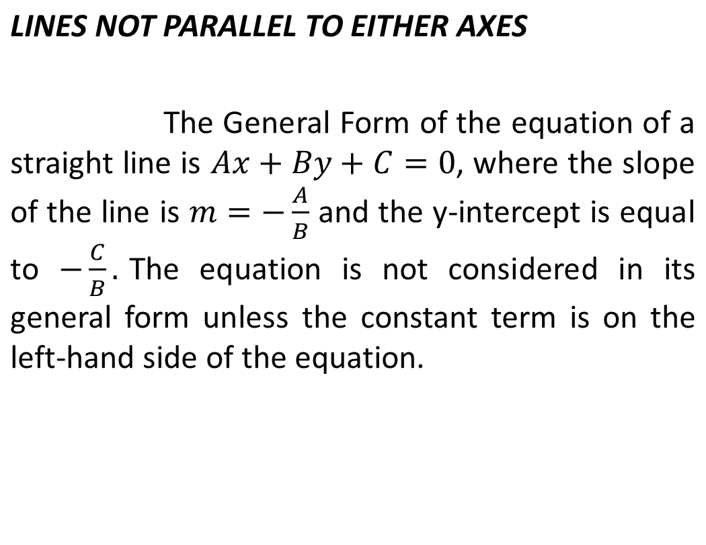

Slide 4
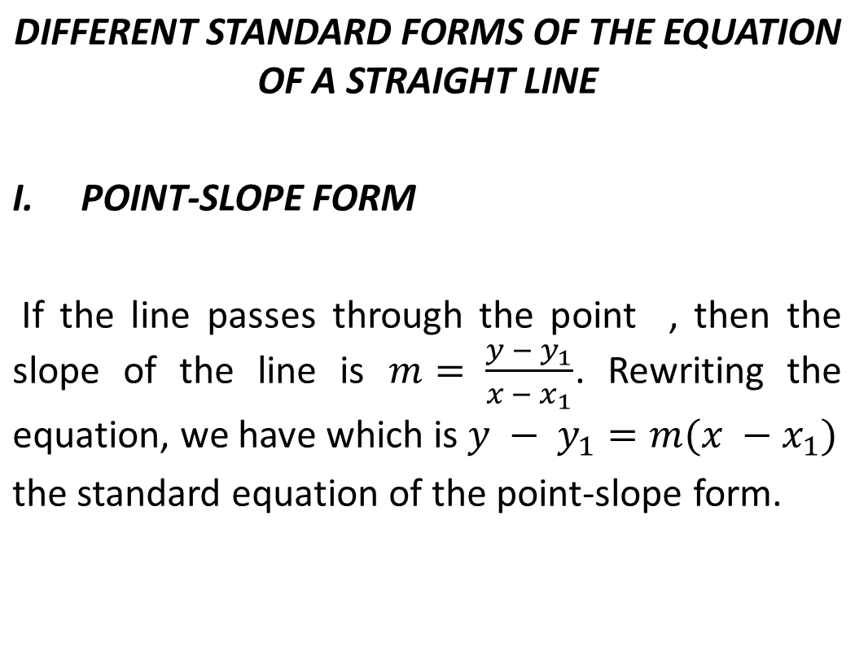

Slide 5

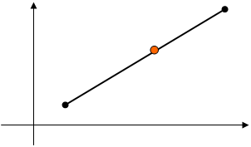


The equation of the line through a given point P₁ (x₁, y₁) whose slope is m.
y
x

Slide 6


Generally,
Considering points P(x, y) and P₁ (x₁, y₁),
Therefore,

Slide 7
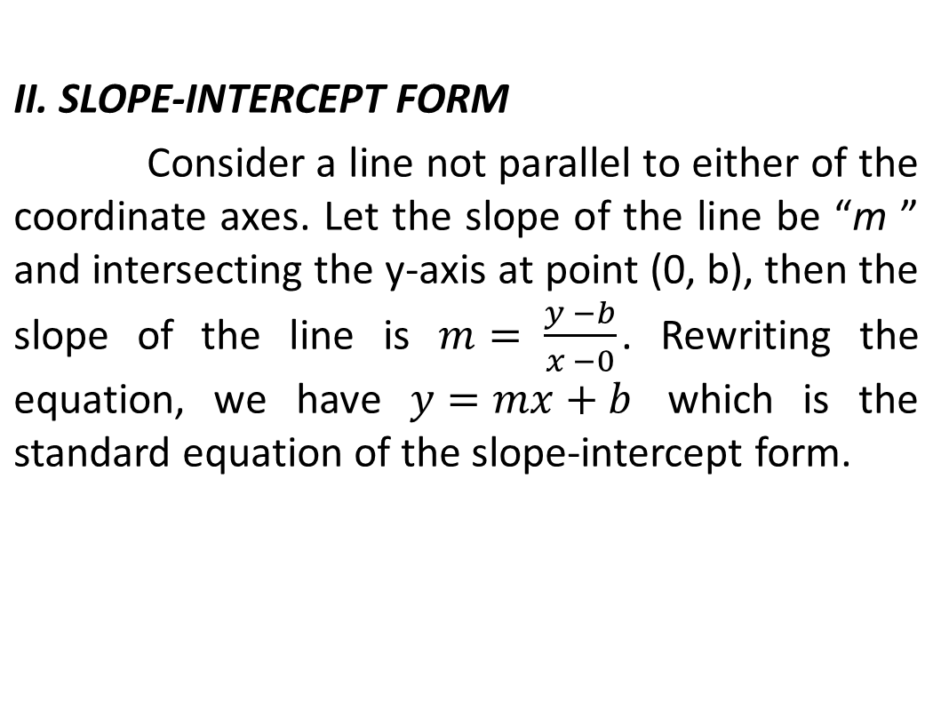

Slide 8
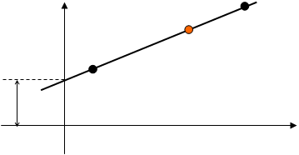
The equation of the line having the slope, m, and y-intercept (0, b)
y
P (x, y)
(0, b)
b
x

Slide 9


Generally,
Considering points P(x, y) and (0, b),
mx = y –b
Therefore,

Slide 10
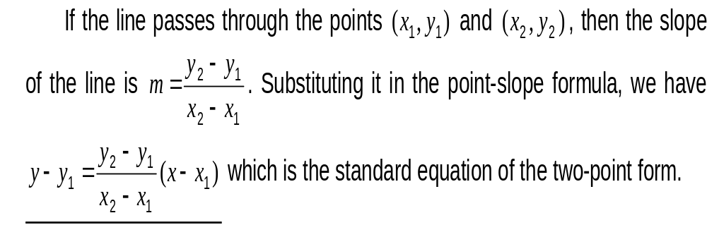
III. TWO POINT FORM

Slide 11
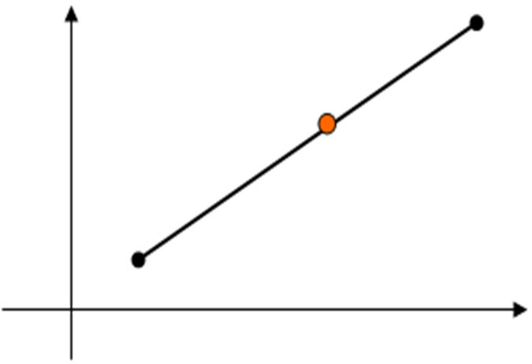
The equation of the line through points P₁ (x₁, y₁) and P₂ (x₂, y₂)
P₂(x₂, y₂)
y
P (x, y)
P₁(x₁ , y₁ )
x

Slide 12



Considering points P₁ (x₁, y₁) and P₂ (x₂, y₂),
1
Considering points P(x, y) and P₁ (x₁, y₁),
2
Equation 1 = Equation 2

Slide 13
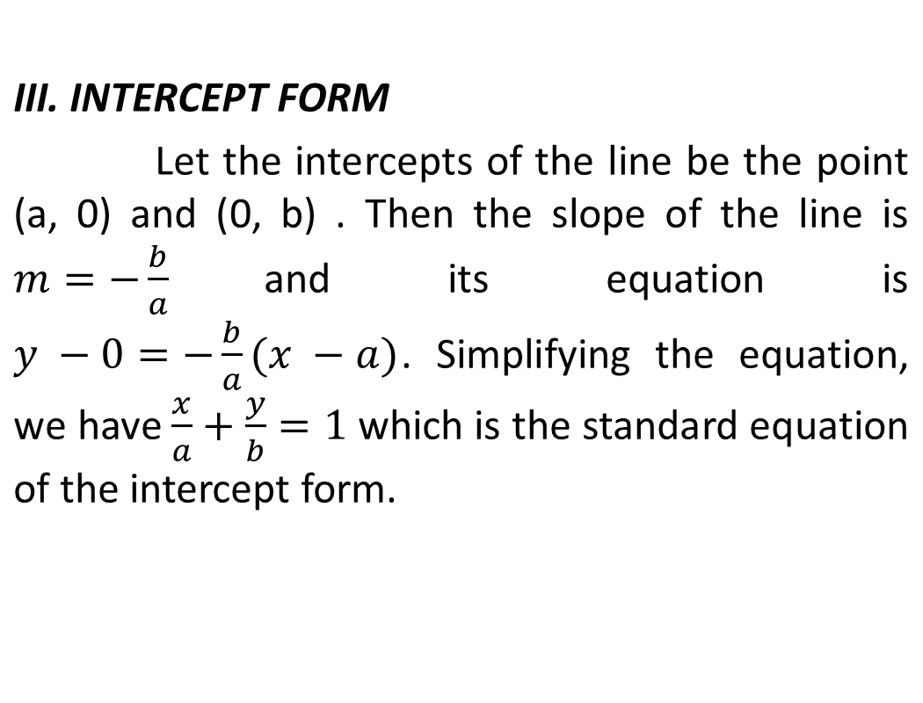

Slide 14

The equation of the line whose x and y intercepts are (a, 0) and (0, b) respectively.
y
B (0, b)
b - y
P (x, y)
b
y
A (a, 0)
x
x
a - x
a

Slide 15




ay = -bx + ab

Slide 16
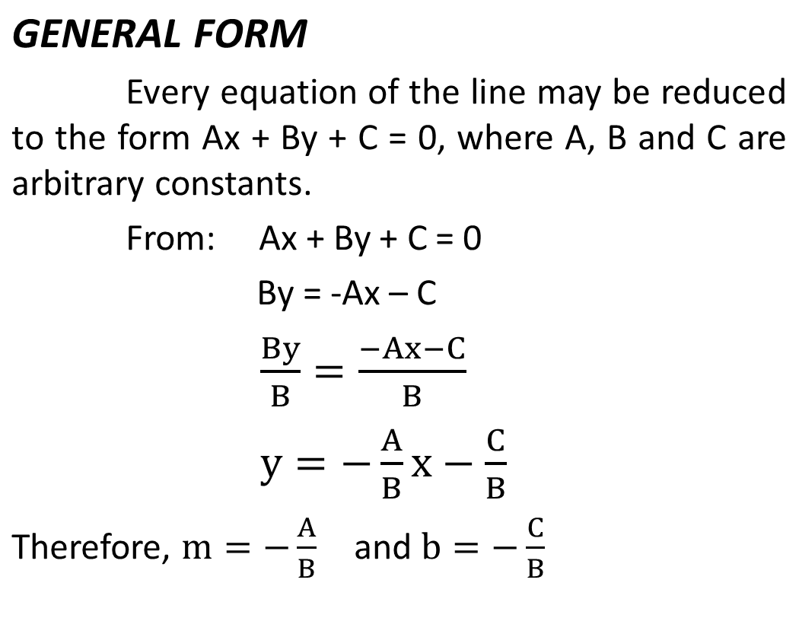

Slide 17
Sample Problems:
Find the slope m and y-intercept for the line 2y + 3x = 7.
Determine the equation of the line satisfying the following conditions:
passing through (2, -3) and parallel to the line passing through (4, 1) and (-2, 2).
passing through point (-2, 3) and perpendicular to the line 2x – 3y + 6 = 0.
which is the perpendicular bisector of the segment connecting points (-1, -2) and (7, 4).

Slide 18
passing through (-2, -7) and has its intercepts numerically equal but of opposite signs.
Find the equation of the line whose slope is 4 and passing through the point of intersection of lines x + 6y – 4 = 0 and 3x – 4y + 2 = 0.

Slide 19
The points A(0, 0), B(6, 0) and C(4, 4) are vertices of triangles. Find:
the equations of the medians and their intersection point
the equations of the altitude and their intersection point
the equation of the perpendicular bisectors of the sides and their intersection points
The equation of the “Euler’s Line”

Slide 20
Calculate the distance d from the line 8x +15y – 24 = 0 to the point ( - 2, - 3).
Determine the equation of the bisector of the angles between the lines L1: 3x – 4y + 8 = 0 and L2: 5x + 12y – 15 = 0.

Slide 21
Seatwork No. 2
1. The points A(1, 0), B(9, 2) and C(3, 6) are vertices of a triangles. Find the eq’ns of its altitudes and their point of intersection.
2. Find the distance between the parallel lines 2x – 5y – 10=0 and 2x – 5y + 4 = 0.
3. Find an equation for the set of all points in the xy-plane which are equidistant from (1, 3) and (-2, 5).
4. Find an equation of the lines bisecting the angle from 8x + 15y – 5 = 0 and 5x – 12y + 1 = 0.

Slide 22
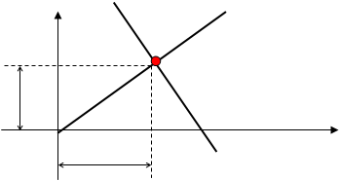

NORMAL FORM OF THE STRAIGTH LINE
A
N
y
C (x₁, y₁)
P
y₁
x
B
x₁

Slide 23
Let: AB – given line
ON – line perpendicular to AB
C– point of intersection with coordinates (x₁,y₁)
Recall: m = tanθ where: m – slope of line
θ – Inclination of line
m_{ON} = tanω therefore, m_{AB} = -1/ tanω
m_{AB} = - cotω
m_{AB} = - cosω/sinω
x₁ = Pcosω
y₁ = Psinω

Slide 24
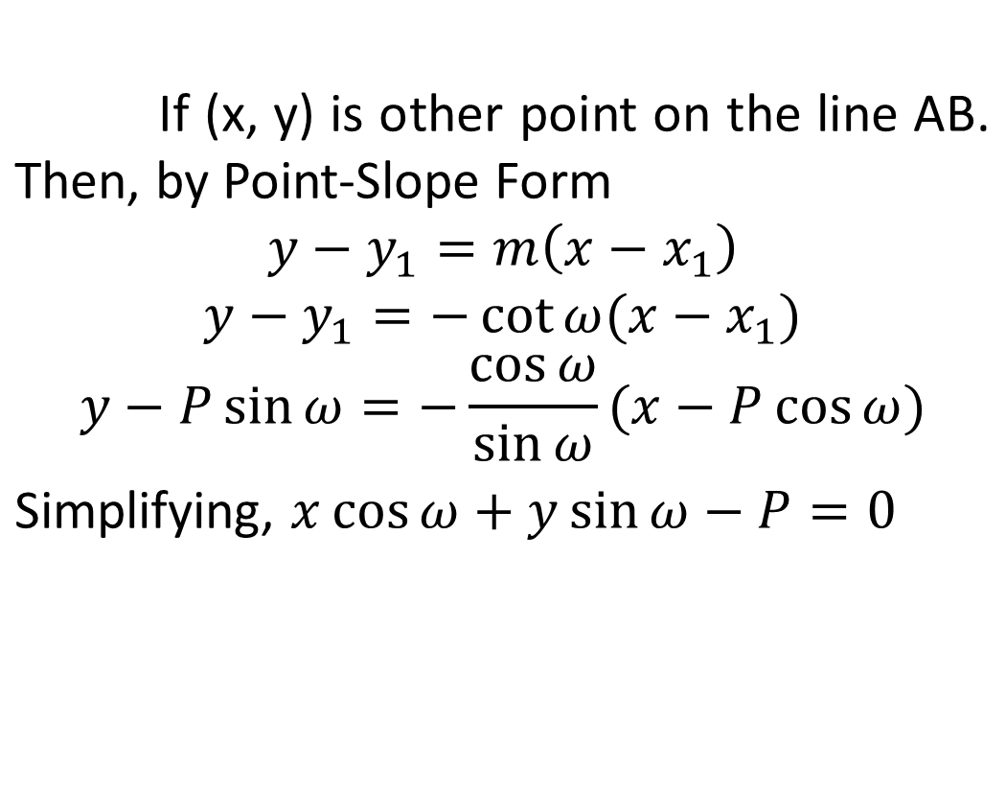

Slide 25
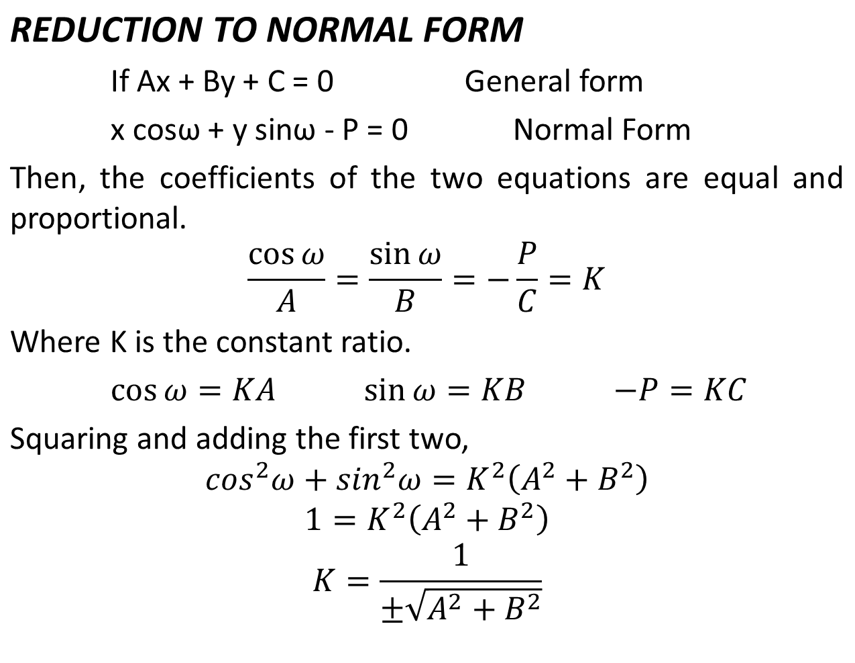

Slide 26
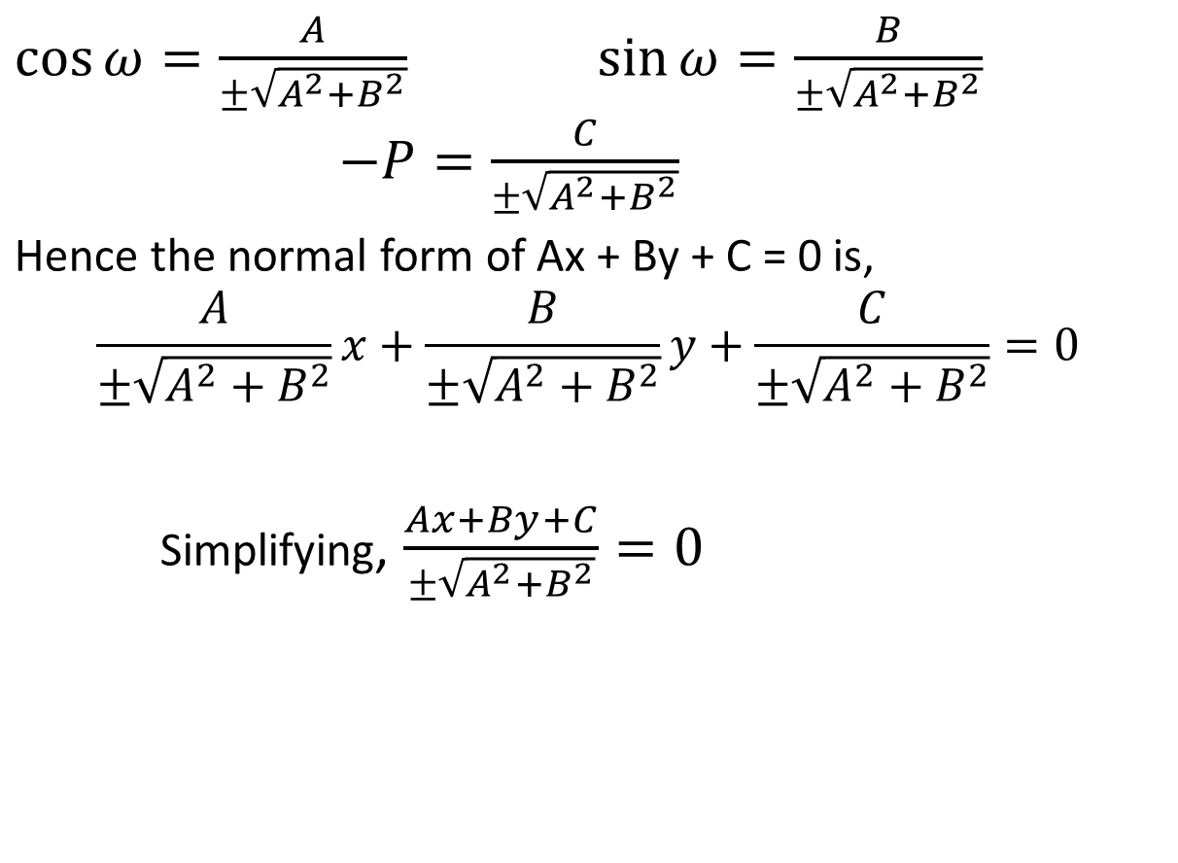

Slide 27
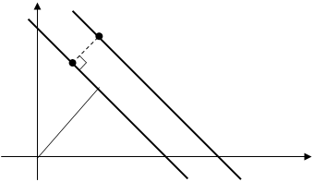
DISTANCE FROM A POINT TO LINE
y
P₁ (x₁,y₁)
d
P
ω
x
L
L₁

Slide 28
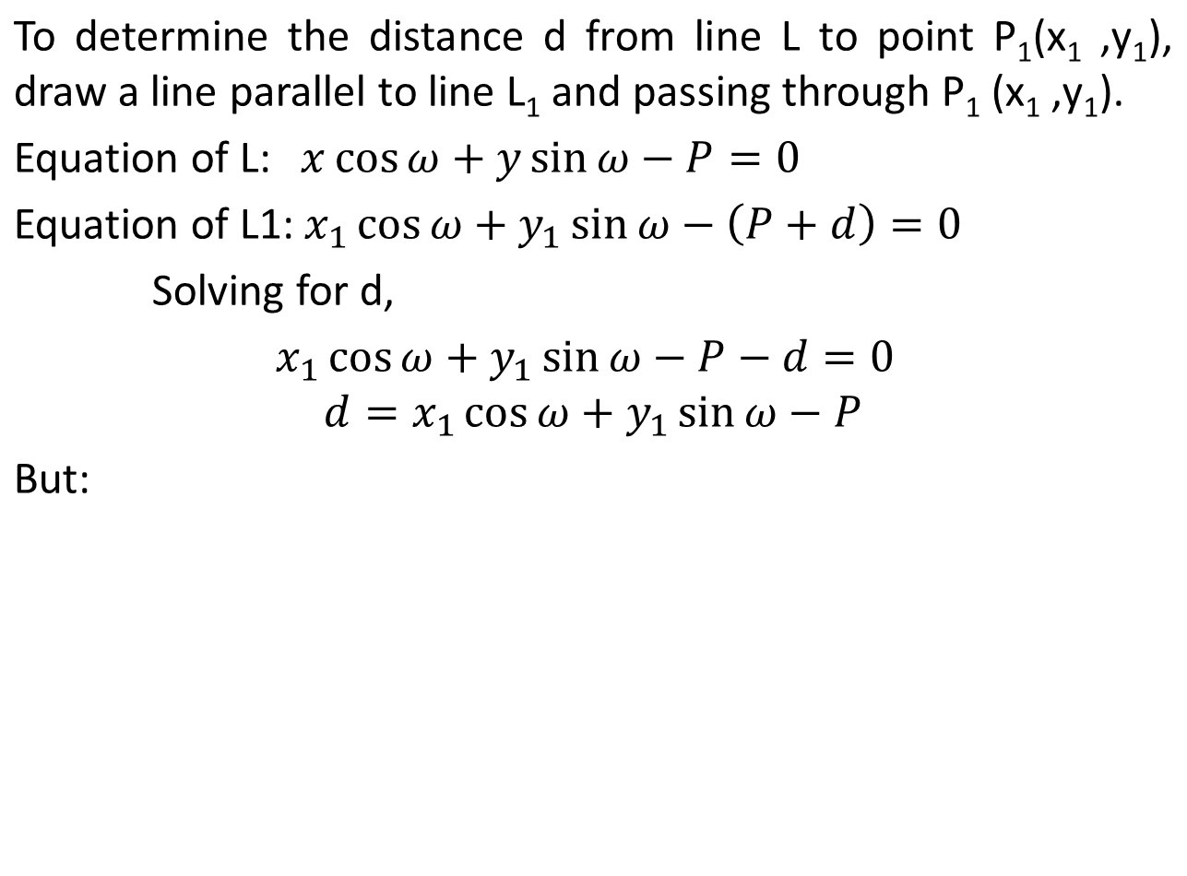


Slide 29
Sign Conventions:
a. The denominator is given by the sign of B.
b. The distance (d) is positive (+) if the point P₁ (x₁ ,y₁) is above the line.
c. The distance (d) is negative (-) if the point P₁ (x₁ ,y₁) is below the line.

Slide 30
Examples:
1. Find the distance from the line 5x = 2y + 6 to the points
a. (3, -5)
b. (-4, 1)
c. (9, 10)
2. Find the equation of the bisector of the pair of acute angles formed by the lines 4x + 2y = 9 and 2x – y = 8.
3. Find the equation of the bisector of the acute angles and also the bisector of the obtuse angles formed by the lines x + 2y – 3 = 0 and 2x + y – 4 = 0.

Slide 31
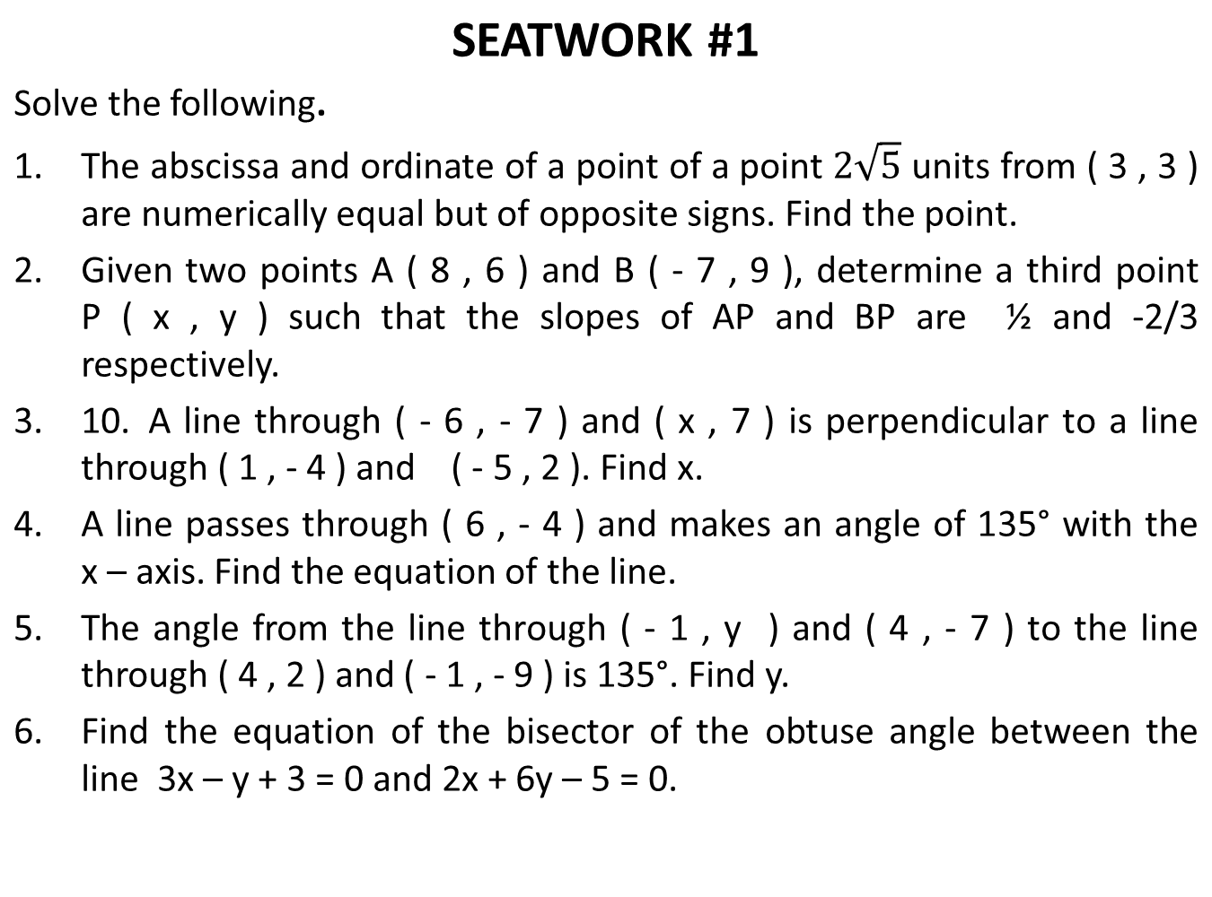

Slide 32
Examples:
I.Find the general equation of the line:
a. through (2, -7) with slope 2/5
b. with slope 3 and y-intercept 2/3
c. passing through (4, -5) and (-6, 3)
d. with x-intercept of 4 and y-intercept of -6
e. with slope 1/3 and passing through (5, -3)
f. passing through (-2, -7) and has its intercepts numerically equal but of opposite signs

